Slide 1


Onderwijsparade 2015
Keynote lecture Stella Cottrell

Slide 2
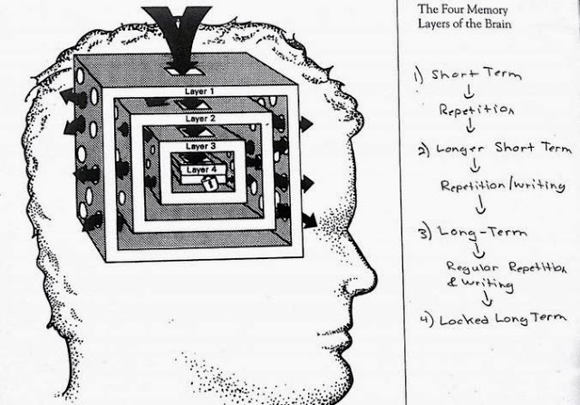
Study skills and learning development for the 21st century
Utrecht
March 2015
Dr Stella Cottrell
Pro-Vice-Chancellor
University of East London
Notes:
LLC photo with permissions

Slide 3
Study skills and learning development…
The shape of things to come…?

Slide 4
Study skills and learning development…
The shape of things to come…?

Slide 5

View from the past
“Books will be gone”
“Students all alone with their computers…”
“Losing the power of speech…their social skills all gone”
“Campuses all gone”
“Lecturers replaced by computers”
Notes:
LLC photos with permissions

Slide 6

Outline
Top 10 trends in study skills for the 21st century
‘Take-aways’
Notes:
All clip art

Slide 7
10.
Study skills will matter more….

Slide 8
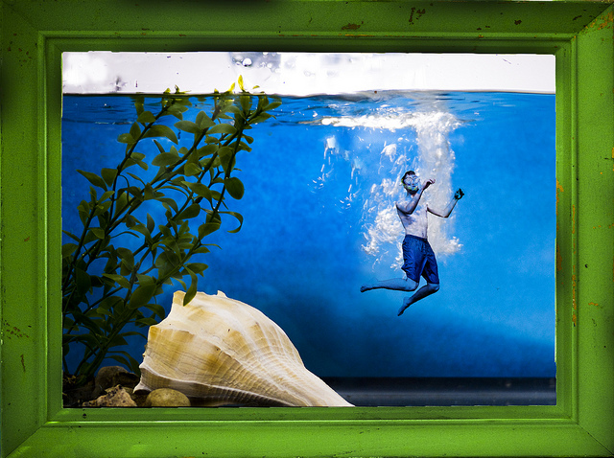

20th century : ‘Sink or swim’
Notes:
Clip art

Slide 9

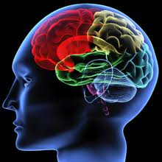
Reliance on the intrinsic strengths of the individual student
Notes:
Clip art

Slide 10
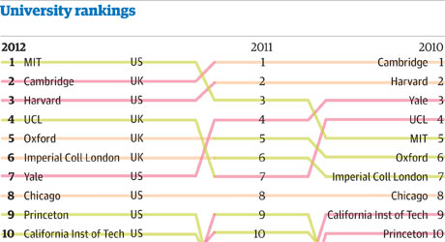

Greater imperatives to address student success
=
Student outcomes
Reputation, income, recruitment, etc

Slide 11
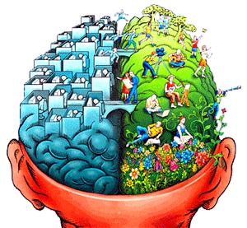
Improved understanding of post-childhood intellectual development
Notes:
Clip art

Slide 12
“Is there any point providing resources to assist students who struggle?”
Early C21st
‘the potential for positive change, or plasticity, is maintained in adult cognition’ (Hertzog et al, 2008)
And is sensitive to lifestyle and physical activity.
Ceci (1991); Brinch and Galloway (2012)
Late C20th
In The Bell Curve (1994), Herrnstein and Murray appeared to have demonstrated that IQ wasn’t amenable to inputs from education and training.
Notes:
LLC photos with permissions

Slide 13
Factors impacting on Achievement
External pressures
Confidence
Expectations of the learning context
Adapting to independent study
Understanding of
academic conventions
Myths about intelligence
Prior taste of academic success
Disability
Family
Coping with change
Isolation and
loneliness
Sterotype theat
Practice
Academic support
Time
Managing choice
Nutrition/health
Learning environment
Peer pressure/
support
Ambitions/motivations
Notes:
Increasingly, we are finding that there are many factors that singly, or in combination, have an influence on student success. If we want our students to be successful, then we need to ensure the appropriate support structures are in place.

Slide 14
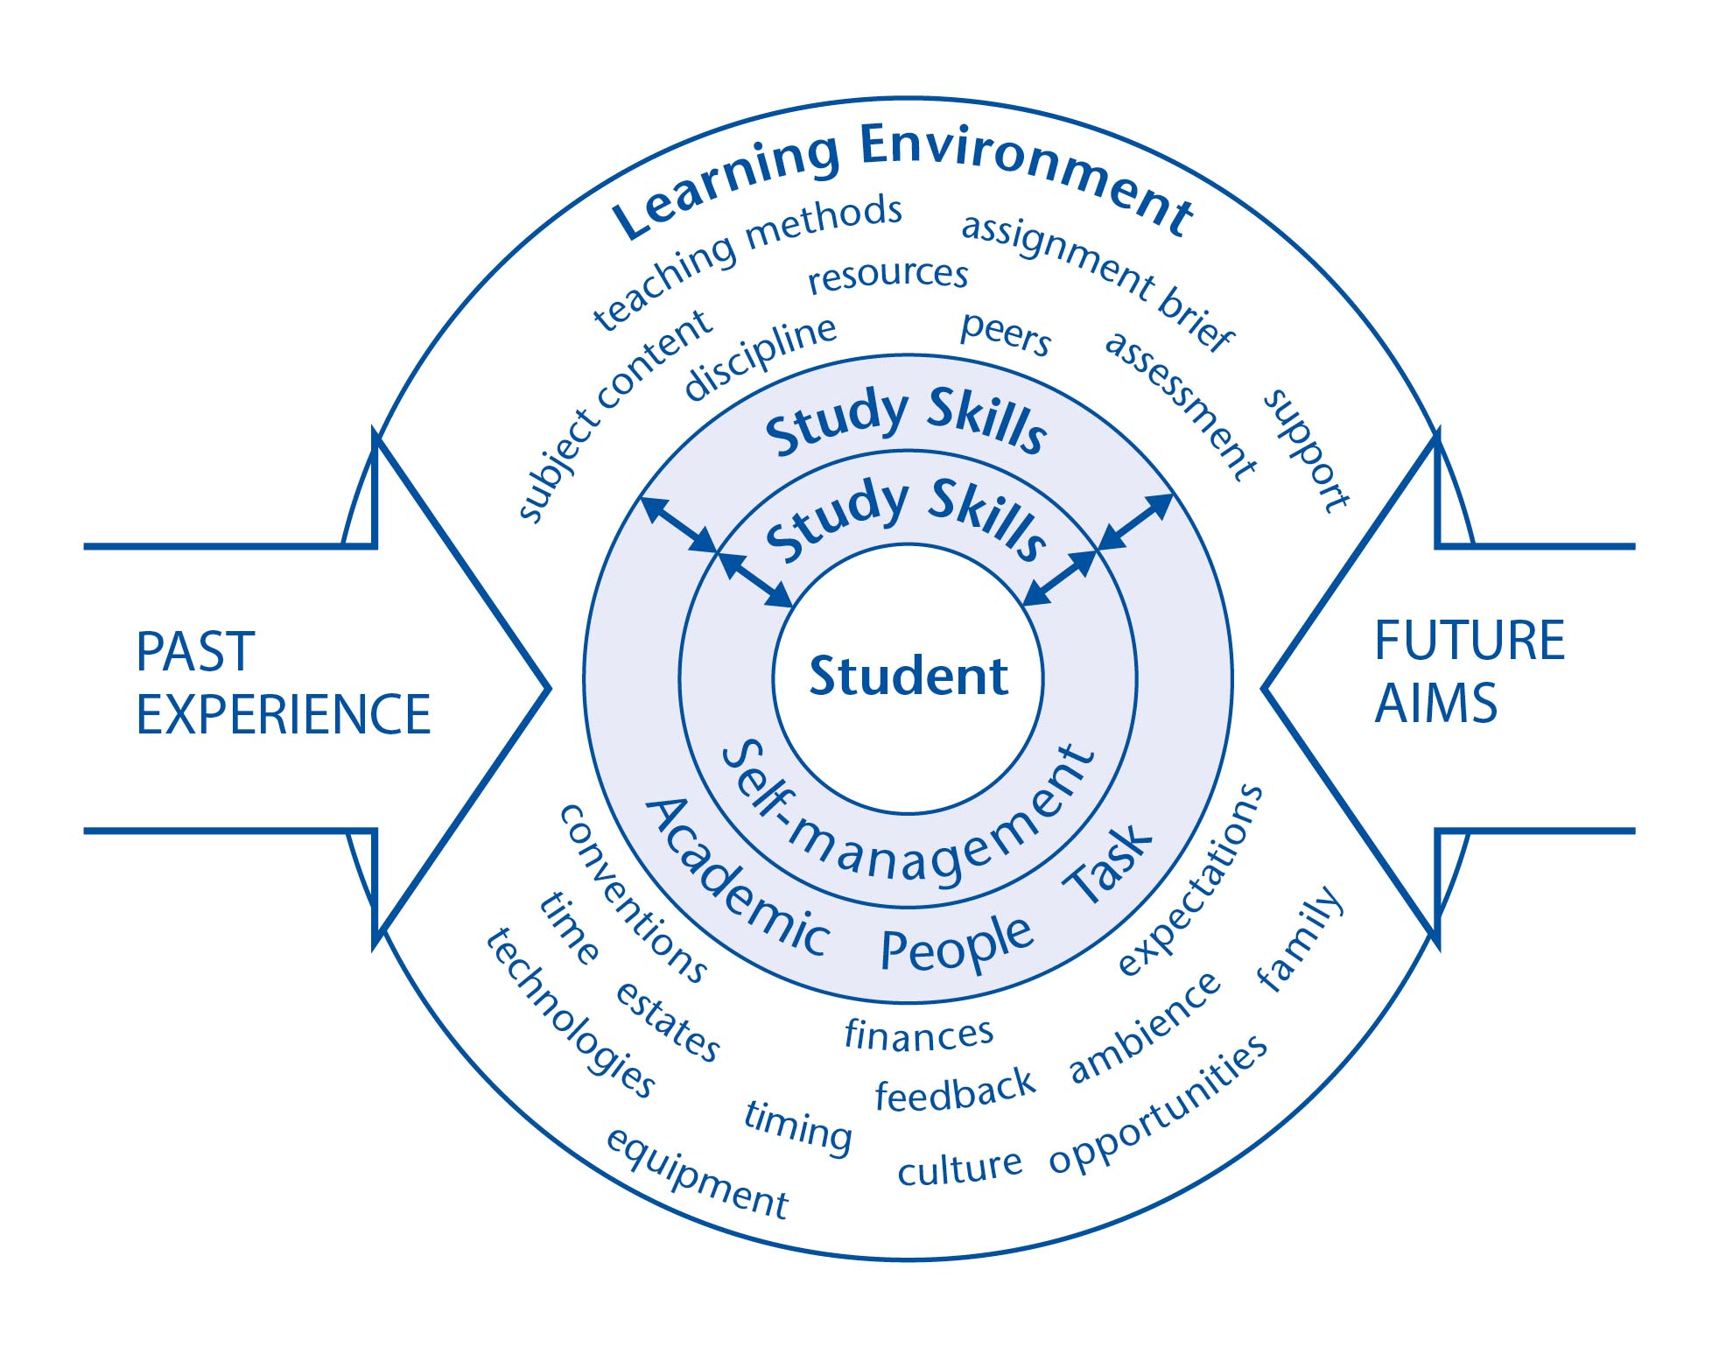
Study skills enabling student to manage the total learning experience

Slide 15
More recognition given to study skills….
‘Flying start’ courses for offer-holders
Across the
student journey
‘Study fest’ events
Student induction and orientation
In feedback strategies – involving students
Career structure for
skills specialists
Supplementary online support
Collaboration between Faculty & Services

Slide 16
9. Increase in multi-faceted, multi-channel, ‘whole university’ approaches

Slide 17
Who should develop students’ skills and qualities?
Academic
study
Specialist services
Whole university
approach
Culture and curriculum
Environment,
resources
and spaces

Slide 18
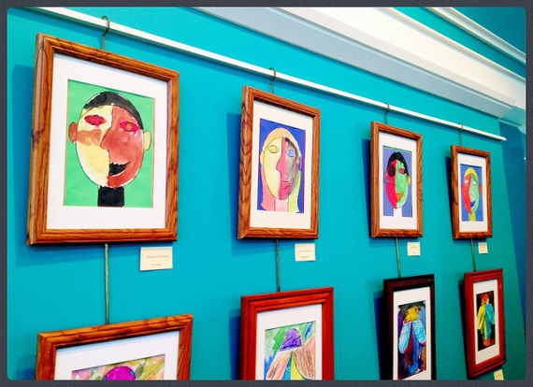
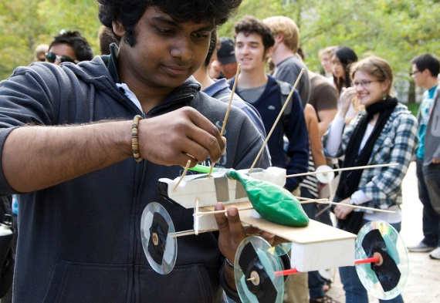
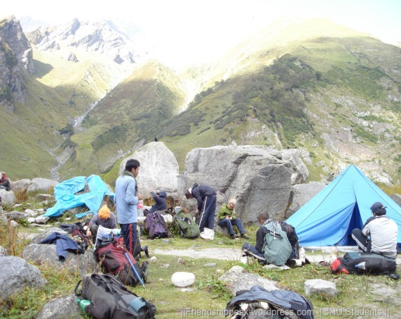
More integrated into teaching
Providing examples of desired end-points (videos or examples of final year work )
Mapping the journey towards success at that end-point
Highlight skills required/acquired
Designing assignments, activities and assessments to enable students to practise/refine skills
Constructive feedback to develop skills & improve performance
Notes:
LLC photos with permissions

Slide 19
Features of skills provision
Systematic
Outcomes-focussed
Integrated
Diagnostics
Developmental for ALL students
Personal planning
Integrated with planning for jobs and careers
Personalised
Adaptive
Students &staff responsible for tracking progress
Targetted
Notes:
19

Slide 20
8. Use of student analytics

Slide 21
Use of analytics
Granular understanding of student profile
Track progress
Pinpoint emerging issues
Target resources
UEL, Derby Manchester Met; E. Connecticut, Winsconsin
ProRetention (Quscience); Signal (Ellycian); Retention Centre (Blackboard); Desire2Learn Student Success System; Qlikview…
Attendance
Punctuality
Use of VLE, library, journals…
Engagement with personal development via e-portfolios
Marks & grades
Notes:
LLC photos with permissions

Slide 22
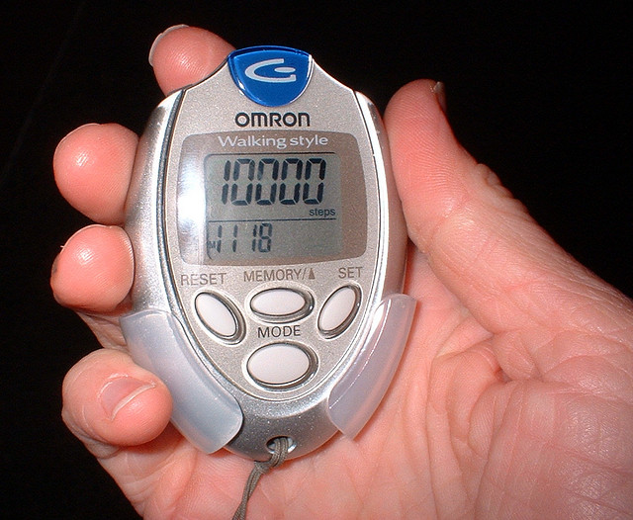
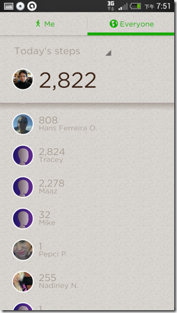
‘The quantified self’ – self-tracking
Notes:
LLC photos with permissions

Slide 23
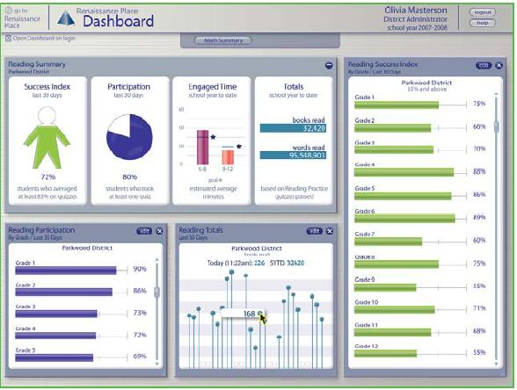
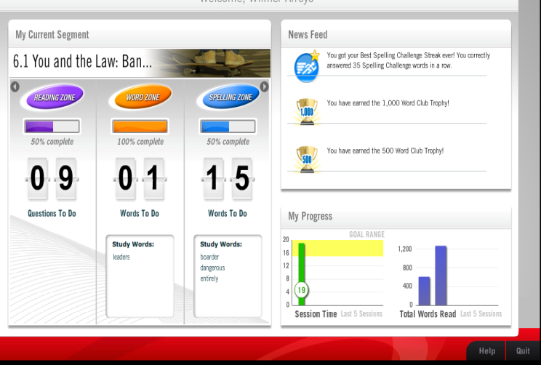
‘The quantified student’
Notes:
LLC photos with permissions

Slide 24
7. Greater awareness of the impact of the relationship between the quality of teaching, study skills needs, and student outcomes

Slide 25
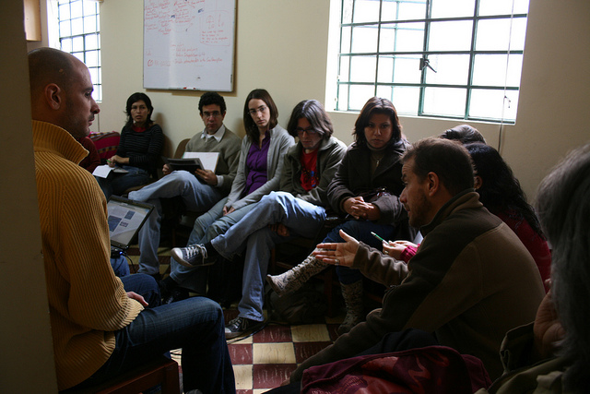
Gathering student views…

Slide 26
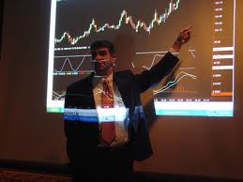
Accessing the information in class
“They stood between me and the board, so I couldn’t see what they were referring to. I got lost after that.”

Slide 27
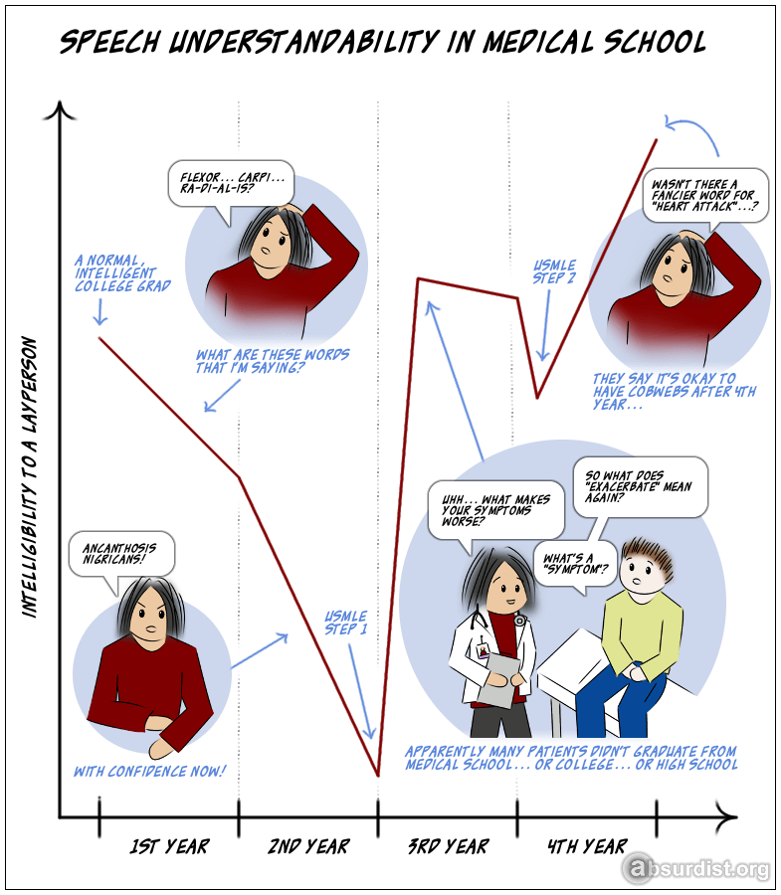
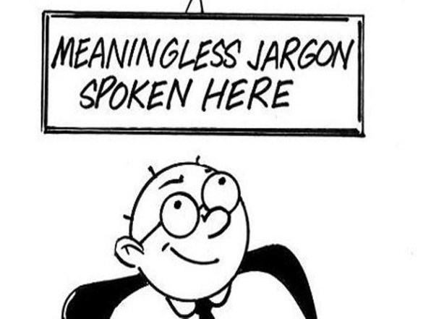
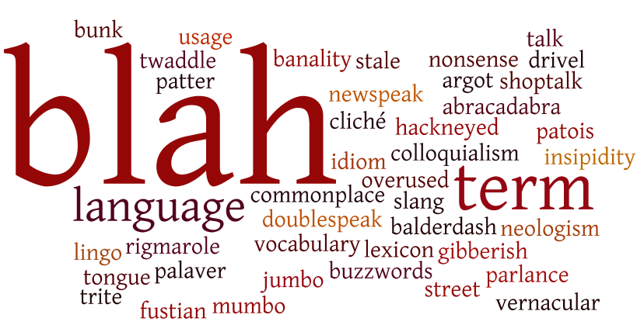
“I couldn’t make sense of what she was saying”

Slide 28
“I couldn’t make sense of what she was saying”

Slide 29
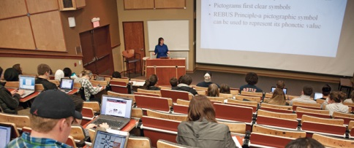
Did she miss out several steps?
Pacing – especially of essential steps and ‘sticky concepts’

Slide 30
“
Often lecturers try to cram too much information onto a single slide and end up with dense text or charts in a font size too small to read. Much like this slide in fact. You’re probably squinting at it now, trying to make sense of what is written down and hoping that I am not talking about something important at the same time because it’s impossible to focus on both at once. If you are really unlucky I am reading this out at the same time, possibly even in monotone, and you might find that the will to live is slowly slipping away from you. Is it? Are you still with me or have you dropped off? I said, have you dropped off? Oh, you are still there - where did you get up to? It doesn’t really matter anyway as I have realised that at this rate I am not going to get through all of my slides in time so I am going to have to speed up and start reading through this really quickly. In a couple of slides time I am going to give up on the reading altogether and start flicking through the slides at a speed fast enough to make you dizzy. You never know, learning might be taking place subliminally.

Slide 31
“We only have a few minutes so I’ll need to speed up.”
Often lecturers try to cram too much information onto a single slide and end up with dense text in a font size too small to read. Much like this slide in fact. You’re probably squinting at it now, trying to make sense of what is written down and hoping that I am not talking about something important at the same time because it’s impossible to focus on both at once. If you are really unlucky I am reading this out at the same time, possibly even in monotone, and you might find that the will to live is slowly slipping away from you. Is it? Are you still with me or have you dropped off? I said, have you dropped off? Oh, you are still there - where did you get up to? It doesn’t really matter anyway as I have realised that at this rate I am not going to get through all of my slides in time so I am going to have to speed up and read very fast! Soon, I am going to give up on the reading altogether and start flicking through the slides just so you know they are there - fast enough to make you dizzy. You never know, learning might be taking place subliminally.

Slide 32

Paced provision of helpful
information: “I’m lost in handouts”

Slide 33
6. HEIs will look to nurture a wider range of skills, qualities, and behaviours …

Slide 34

20th century study skills ?
Traditional study skills
Making notes
Reading
Organising material
Time management
Writing essays, reports, dissertation
Contributing to seminars
Revision and exams
Notes:
Clip art

Slide 35
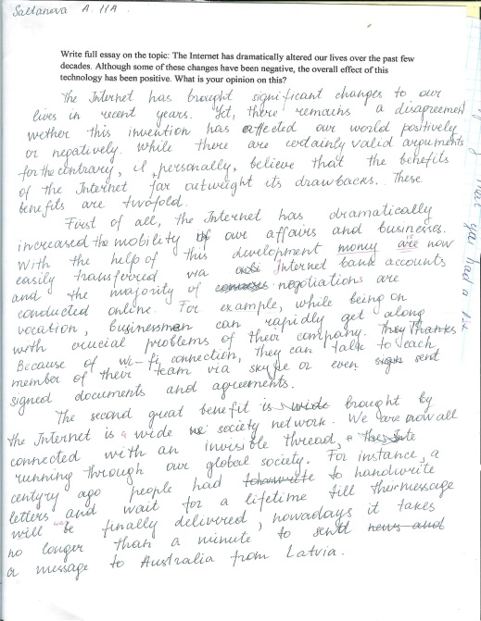
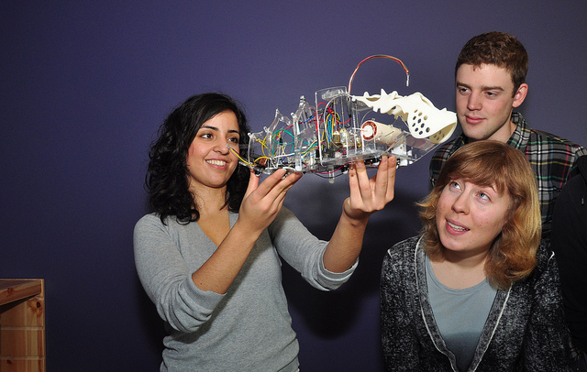
Expect students to ‘engage’
Cognitively - in their learning, in compound assignments, in making and doing things
In co-curricular activities
In research
In the design of learning
As partners – with rights & responsibilities and in deliberative structures
Notes:
LLC photos with permissions

Slide 36
What skills do employers seek in graduates? ‘Future Fit’(CBI 2009)
Confederation of British Industry
Self-management
Awareness of business & customer issues
Ability to work within a team
Written communication
Numerical skills
Ability to solve problems and generate solutions

Slide 37

Internationalisation
Mobility
‘Global issues’
Cross-disciplinary & trans-national
Notes:
Clip art

Slide 38
A wider variety of learning and teaching methods
Projects Apps Guest speakers
Labs lecture flipped classroom Groups Reflective blogs Peer learning Field trips Maker/fabricants Enquiry-based Discussion board Adaptive ‘voting’ Studio
Online Independent study VLE Tutorials Tablets Volunteering mobile Industrial placements Clinical practice Seminars

Slide 39
Engaged in a range of assignments and assessment
Live client brief
Wikis
App Review
Business plan
Essays
Quizzes
Contributions to discussion boards
Book review
Solo project
Mini-drama
Storyboard
Posters
Design an App
Group journal
Magazine
Collaborative projects
Presentations
Simulations
Analyse online video
Reports
Tests
Survey
Blogs
Reflection
Film review
Group E-book
Exams

Slide 40
… and use technologies
Public response systems (clickers)
Games; challenges; competition; quizzes; peer ratings & ‘leagues’
Adobe connect: for group work off campus
Photos & video for portfolios
Using devices
Sharing – sites, references, bookmarks
In online group projects
YouTube and video
via phones
Animations
e-books Live chat
Discussion boards

Slide 41
They still need core study skills…
Critical selection
Information
management
Critical analysis
Memory
Research skills
Academic integrity
Using
data
Independent
study
Problem
solving
Presentations

Slide 42
And further skills demands…
Technological
Synthesis
Reflection
Peer learning
Teamwork
Audience awareness
Work-related
Collaborating with wider range of people earning
Advanced
Search skills
Personal
development
planning
Writing for wider
range of audiences

Slide 43
And more skills and attributes
Manage complex assignments
Creativity
Leadership
Negotiation
Enterprise
Flexibility
Networking
Emotional intelligence
Project management
Cultural sensitivity
Global citizenship
Civic engagement
Business acumen
Sustainability
And more…
And more….

Slide 44
5. Streamlined, clearer frameworks to help students manage skills demands

Slide 45


Academic skills

Slide 46

People skills…

Slide 47
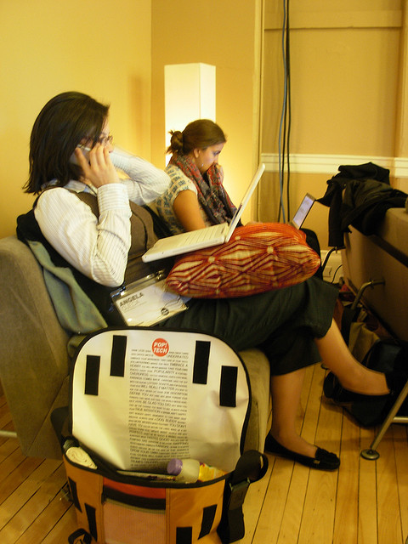
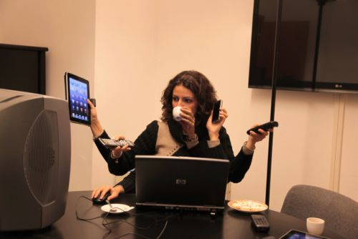
Task-management skills…

Slide 48

Self-management skills…

Slide 49
Greater and broader skills demands
A
T
Traditional
A
P
T
A
P
T
S
Trajectory

Slide 50
Academic People Task Self
A
Academic skills: e.g. critical analysis; making sense; decision-making; synthesis; problem-solving; memory; reflection; integrity
P
People Skills: e.g. with tutors & staff; briefs for employers; participants in projects; in face-to- face and online sessions; peer activity
T
Task Management: e.g. complete start to finish; organise; prepare; plan; be systematic for assignments, exams, projects, client briefs
S
Self-Management Skills: e.g.managing time; life skills; emotional intelligence; self-motivation; self-reliance & coping skills
Stella Cottrell (2013) Study Skills Handbook, (3rd edn) Palgrave McMillan

Slide 51
4. Increasing emphasis on self-management abilities

Slide 52
APT-S Skills framework
Self-Management Skills
managing life demands, etc
emotional intelligence
self-reliance & coping skills autonomy; independent study
Self-awareness and reflection on own performance
S

Slide 53
Emotional self-management skills
Self-reliance
Motivation
Flexibility
Resourcefulness
Mindfulness
Resilience
Emotional
intelligence
Coping with uncertainty & ambiguity
Independence
Responsibility
Identifying personal barriers & resources

Slide 54
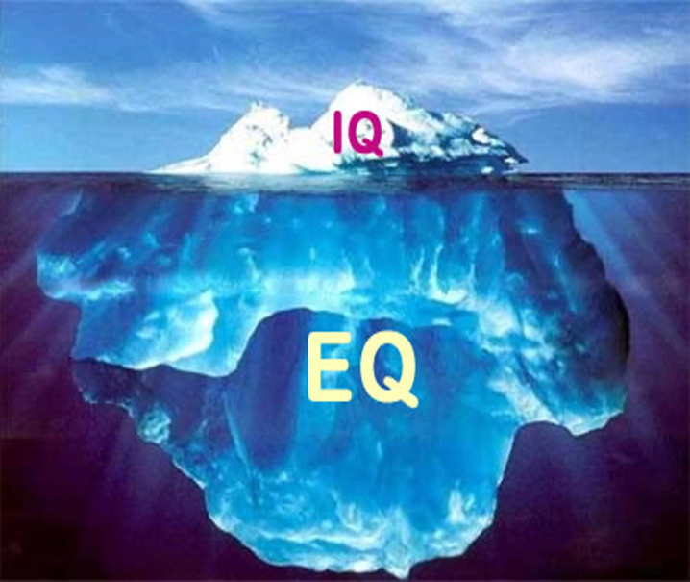

Slide 55
Self-evaluation of own learning preferences: e.g. level of stimulus
High stimulus | Rating | Low stimulus
I need to work in bright room | 3 2 1 0 1 2 3 | I need to work in dim light
I work best when it is very hot (or cold) | 3 2 1 0 1 2 3 | I work best in moderate temperature
It helps me to think if I walk about | 3 2 1 0 1 2 3 | I can’t think if I am moving about
I prefer to work on many things at once | 3 2 1 0 1 2 3 | I need to finish one thing before starting another
Etc. | 3 2 1 0 1 2 3 | Etc.

Slide 56
Learning Preferences: global: serial
Global | Rating | Serial
I start off by gaining a broad overview | 3 2 1 0 1 2 3 | I start off from interesting detail
I map out the subject in a chart | 3 2 1 0 1 2 3 | I prefer to find logical sequence
I work from fully rounded examples | 3 2 1 0 1 2 3 | I work from a clear list
I use ‘picture’ notes or ‘mind maps’ | 3 2 1 0 1 2 3 | I use headings and bullets
Etc. | 3 2 1 0 1 2 3 | Etc.

Slide 57






SHAPE
- A reflective tool for analysing own performance
Weak (-)
Strong (+)
S
H
A
P
E
S
Skills
Habits
Attitudes
Preferences
Experience
H
A
P
E

Slide 58
Start with reflection on SHAPE
⇦Weaker
Stronger ⇨
S
Skills – academic, people, task, self management
Habits – for study
Attitudes - motivation and self-reliance
Preferences – learning ‘styles’, needs, likes
Experience – of recent and successful study
H
A
P
E
S
H
A
P
E

Slide 59
SHAPES – add strategy
⇦Weaker
Stronger ⇨
Skills
Habits
Attitudes
Preferences
Experience
Strategy
S
H
A
P
E
S

Slide 60
SHAPES: develop over time
Noleen: week 1
Noleen: week 8
⇦Weaker
Stronger ⇨
⇦Weaker
Stronger ⇨
S
S
H
H
A
A
P
P
E
E
S
S

Slide 61
SHAPES: over time
Kate: week 1
Kate: week 8
⇦Weaker
Stronger ⇨
⇦Weaker
Stronger ⇨
S
S
H
H
A
A
P
P
E
E
S
S
Kate’s awareness of her learning preferences as well as more experience of study has improved her attitudes to study and her study habits

Slide 62
3. Wider range of ‘peer’ schemes

Slide 63
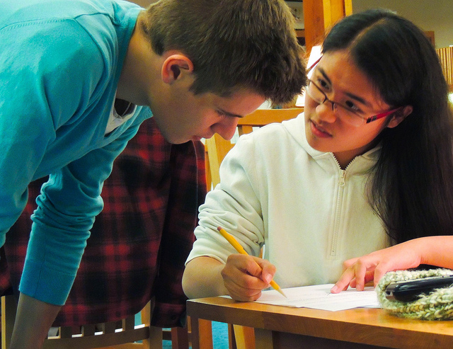
Support from ‘peers’ and recent graduates
Cross-year input at student induction
PALS (Peer Assisted Learning Scheme)
Peer mentoring/ study buddies
Learning Achievement Assistants (LAAs)

Slide 64
2. Responding to the impact of technology

Slide 65

Challenges of Technology-enhanced learning tasks
Great opportunities - but need new skills in…
managing quantity and quality of information
preparing in advance for ‘flipped classroom’
applying study skills when working with mobile devices
combining technologies and using the apps and resources available
Social networking and Apps are great – but what have they got to do with study?

Slide 66


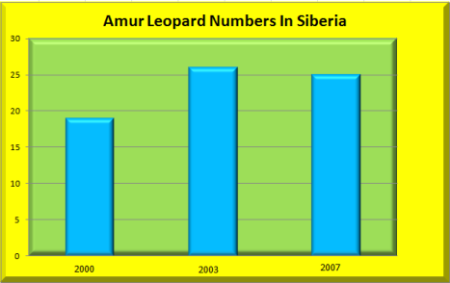



Slide 67
Attention to detail & sequence
 |  |  | ?
Options
A | B | C | D

Slide 68

“the magic meme… a revolution happening right now”
Wired

Slide 69
Have you started your essay yet Phil? Bob has …. And he’s had his ‘5-a-day’ today too

Slide 70
And on page 5 of that essay you’re writing, your assertions about Hegel’s Philosophy of Mind aren’t entirely convincing …

Slide 71
1. More emphasis on engagement, enjoyment, ‘fun’ and hands-on learning

Slide 72
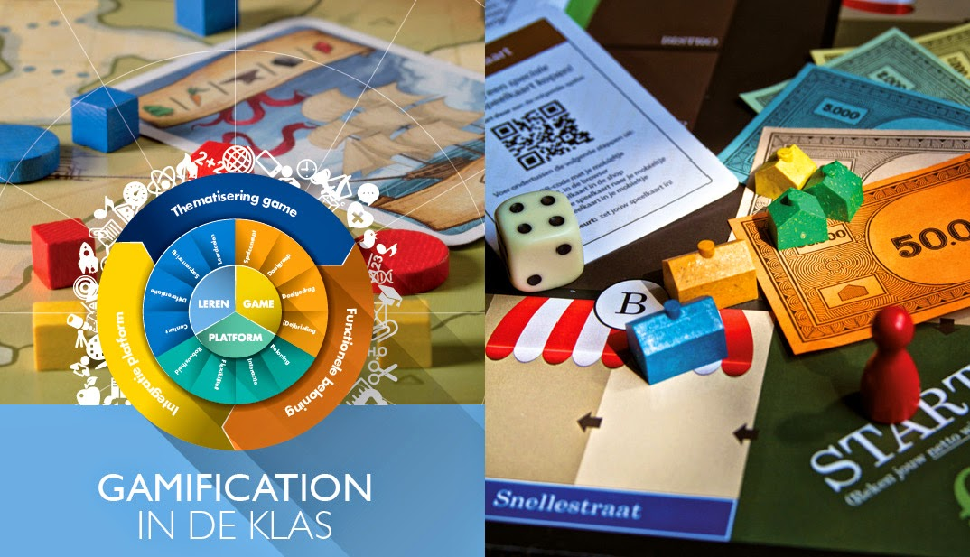
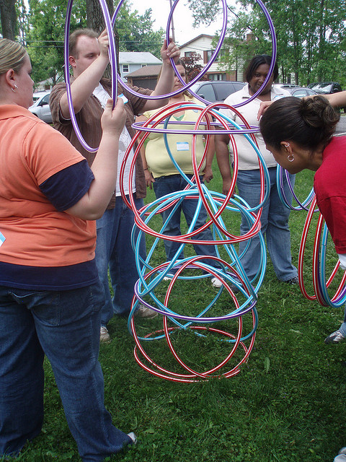
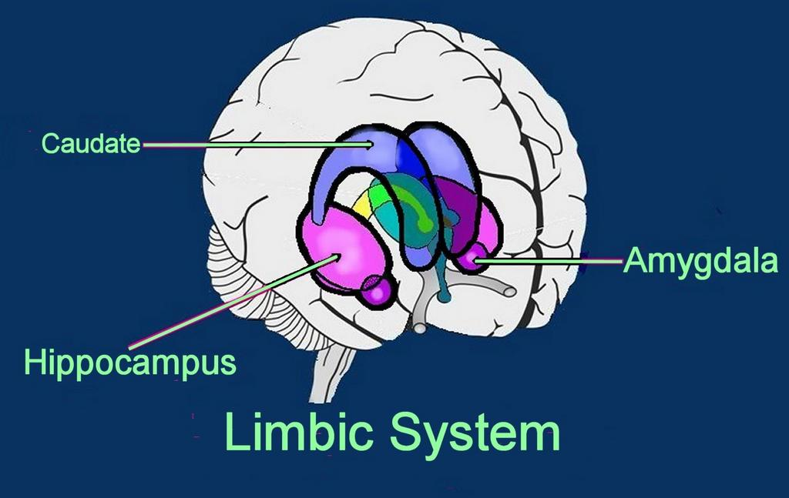
Affect and enjoyment

Slide 73
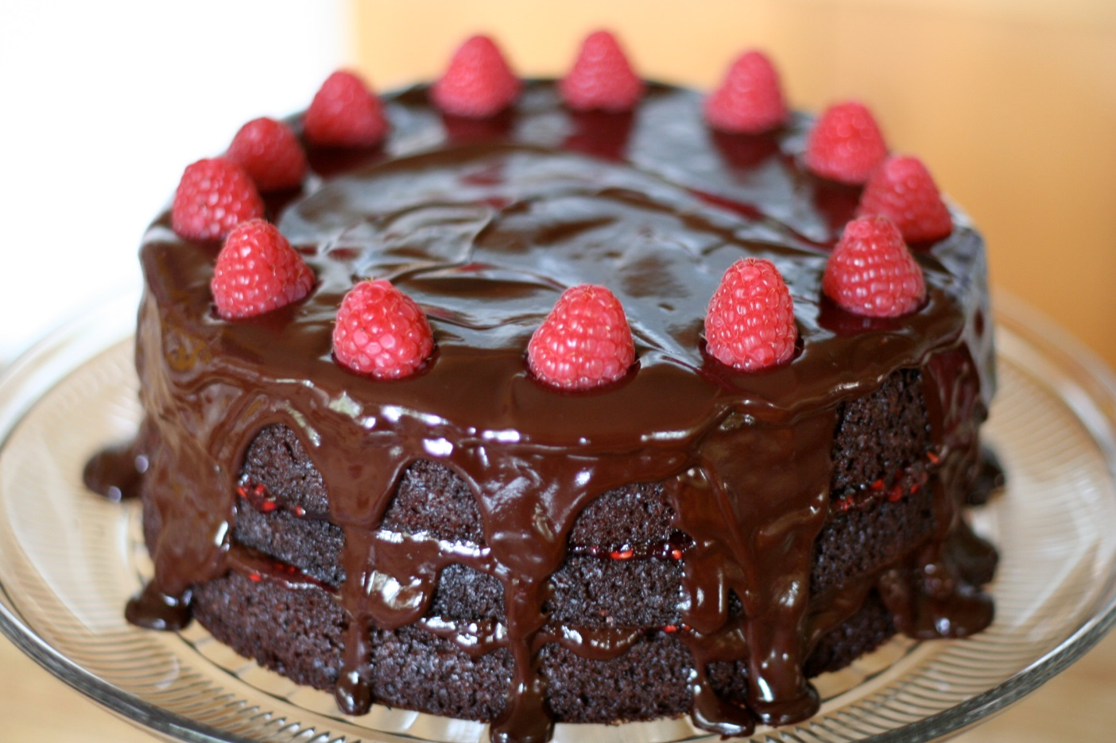
Study skills through chocolate cake: finding the fun & making the point

Slide 74
Check the assignment brief
Make a chocolate cake
Round in shape
Iced or decorated
Serves 6-8 people
Tastes good
Completed
Not sliced or cut
Original; your own work

Slide 75

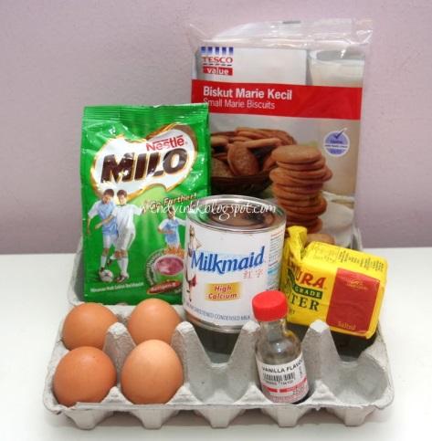
Follow the brief exactly:
Not just about collecting together the right ingredients …
There is a craft.

Slide 76
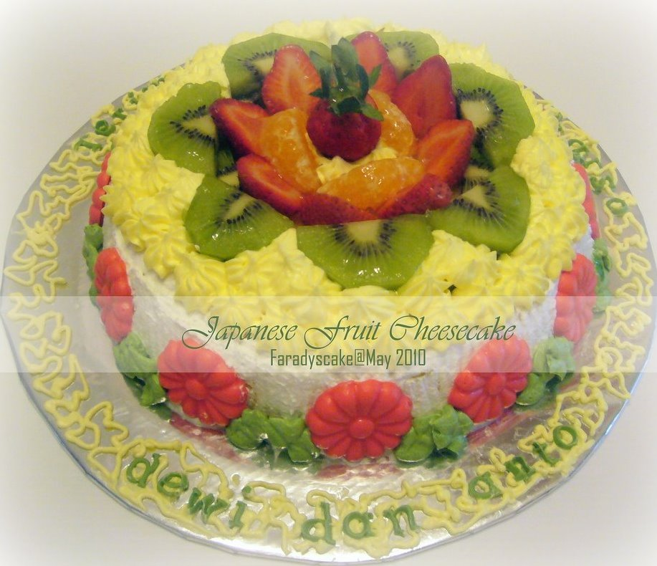
Follow the brief exactly:
Great work- but is it on topic?
Chocolate cake?
Round in shape?
Iced or decorated
Size: serves 6-8 people
Taste good
Completed
Not sliced or cut
Original; your own work

Slide 77
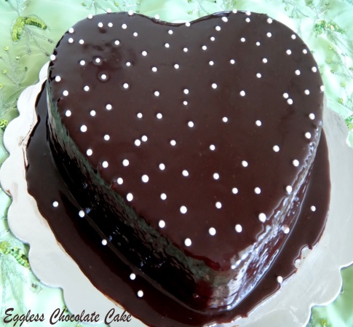
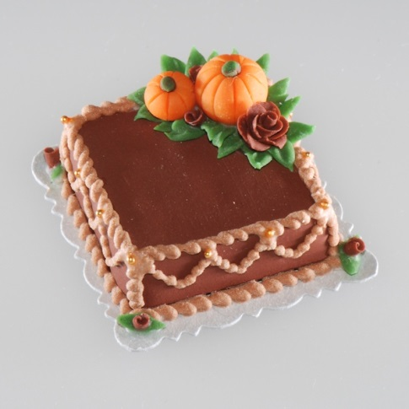
Follow the brief:
Good ideas but right structure?
Chocolate cake
Round in shape?
Iced or decorated
Size: serves 6-8 people
Taste good
Completed
Not sliced or cut
Original; your own work

Slide 78
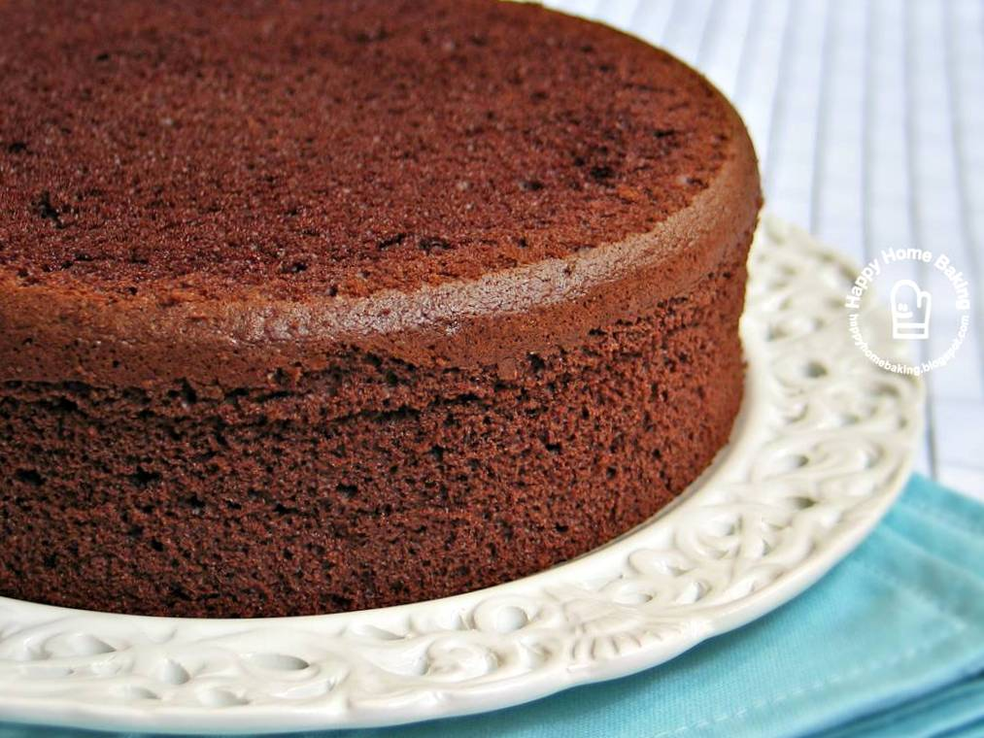

Follow the brief:
Sound work but right presentation?
Chocolate cake
Round in shape
Iced or decorated?
Size: serves 6-8 people
Tastes good
Completed
Not sliced or cut
Original; your own work

Slide 79
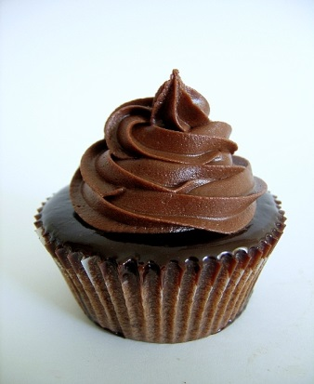
Follow the brief:
Great work but to scale /word limit?
Chocolate cake
Round in shape
Iced or decorated
Size: serves 6-8 people?
Tastes good
Completed
Not sliced or cut
Original; your own work

Slide 80

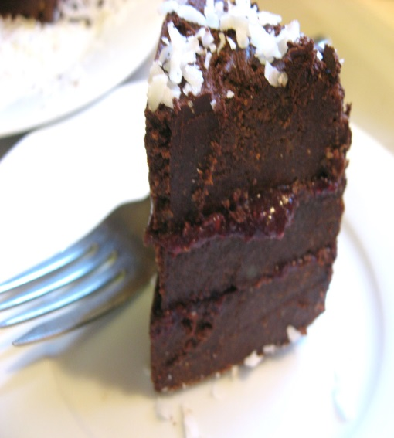
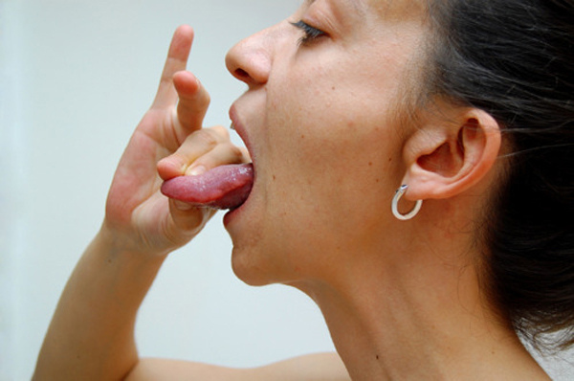
Follow the brief: with the right ingredients/content?
Chocolate cake
Round in shape
Iced or decorated
Size: serves 6-8 people
Tastes good?
Completed
Not sliced or cut
Original; your own work

Slide 81
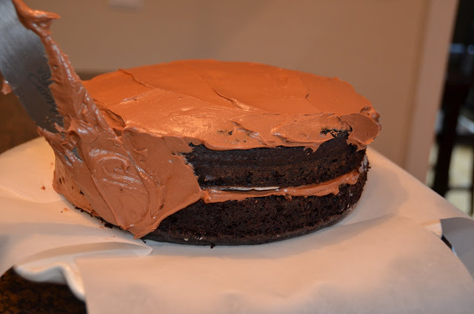
Follows the brief exactly- finished to deadlines
Chocolate cake
Round in shape
Iced or decorated
Size: serves 6-8 people
Taste good
Completed
Not sliced or cut
Original; your own work

Slide 82

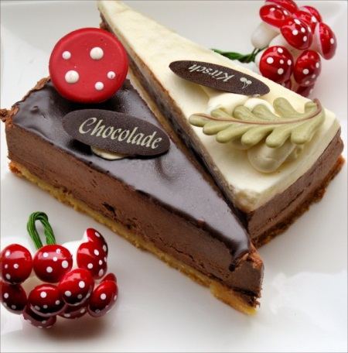
Follow the brief: in all details?
Chocolate cake
Round in shape?
Iced or decorated
Size: serves 6-8 people
Taste good
Completed
Not sliced or cut
Original; your own work

Slide 83
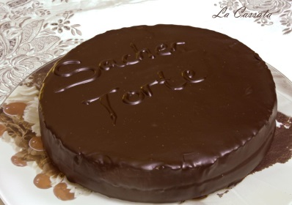
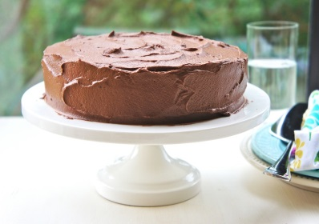

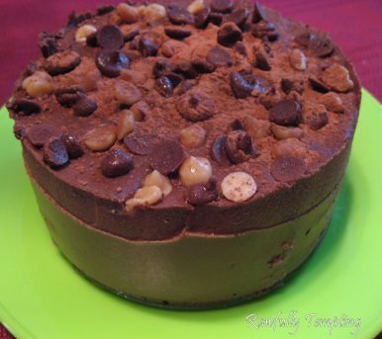
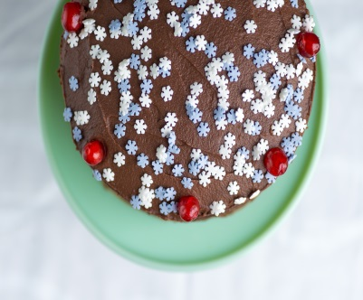

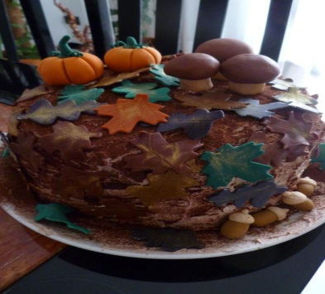
Originality: Many ways to complete the same assignment brief
Chocolate cake
Round in shape
Iced or decorated
Size: serves 6-8 people
Tastes good
Completed
Not sliced or cut
Original; your own work

Slide 84

Academic Integrity
An exact copy of another cake
A rough copy of another cake
Cut and pasted ideas from more than one other cake

Slide 85
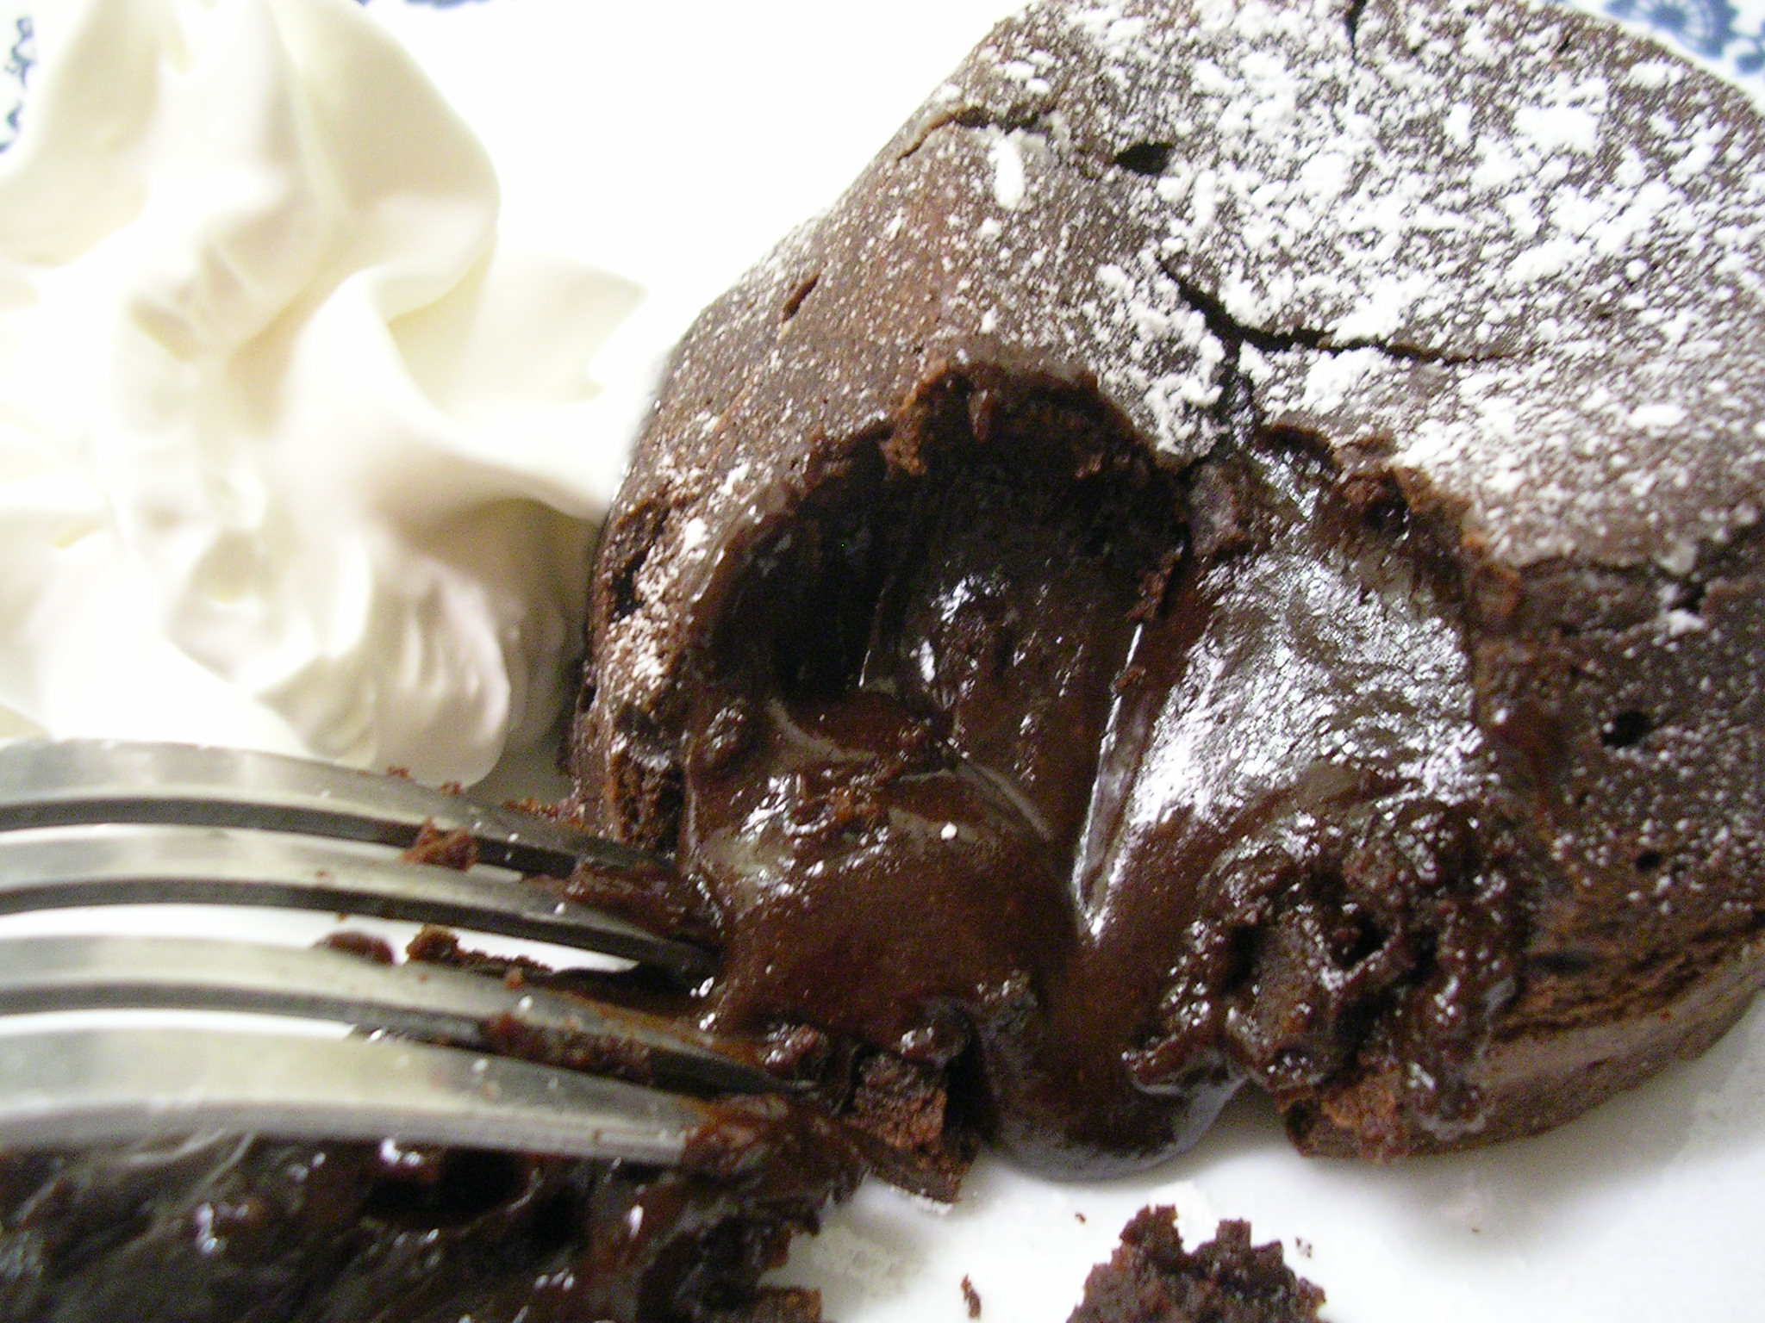
There was a lot of cake to eat that week!

Slide 86
And then what?
What’s next?

Slide 87
Thank you!

